Slide 1

STRATEGIC BUSINESS ANALYTICS PLAYBOOK
DATA SIGNAL VS. NOISE
Draw a conclusion for an experiment

Slide 2
To get started
Make a Copy of this Google Slide deck and complete your assignment on these slides, then submit the link to this deck in the Learning Management System.
Instructions
Go to File > Make a Copy > Entire Presentation
Choose the folder in your Drive where you want to save the slides
Rename your copy and add your name to the file
Example: Playbook Assignment: Draft a business analytics project plan-MRogers Watch this video for a quick demo

Slide 3
Draw a conclusion for an experiment
For most experiments, there is no way to collect data on the entire group of interest you want to reach. One way statisticians deal with this limitation is by working with a sample. They take what they learn from the sample and estimate or predict how it might apply to the entire population.
In this assignment, you will calculate summary statistics and use an online calculator to provide a p-value. You will use the value to draw a conclusion for an experiment.
REVIEW IT
TRY IT
APPLY IT
SUBMIT IT
© 2020 GreenFig | Proprietary and Confidential | Do not duplicate or distribution without written permission.

Slide 4
Introduction
Last week you set up of an experiment to test two versions of the Uber Eats order page.
Recall that Uber’s food delivery platform displays grocery stores, restaurants and eateries by rank. The team wants to understand the level of detail on the order page that works better to improve click-through rates from the order page to adding a food item to the cart on desktop.
Now that you’ve run several tests, you’ll use the knowledge you gained this week to review the test results. You’ll use a spreadsheet and an online calculator to calculate p- values and draw a conclusion.
Work with the experiment results in the worksheet provided, then transfer your final answers to the playbook.
REVIEW IT
TRY IT
APPLY IT
SUBMIT IT
© 2020 GreenFig | Proprietary and Confidential | Do not duplicate or distribution without written permission.

Slide 5
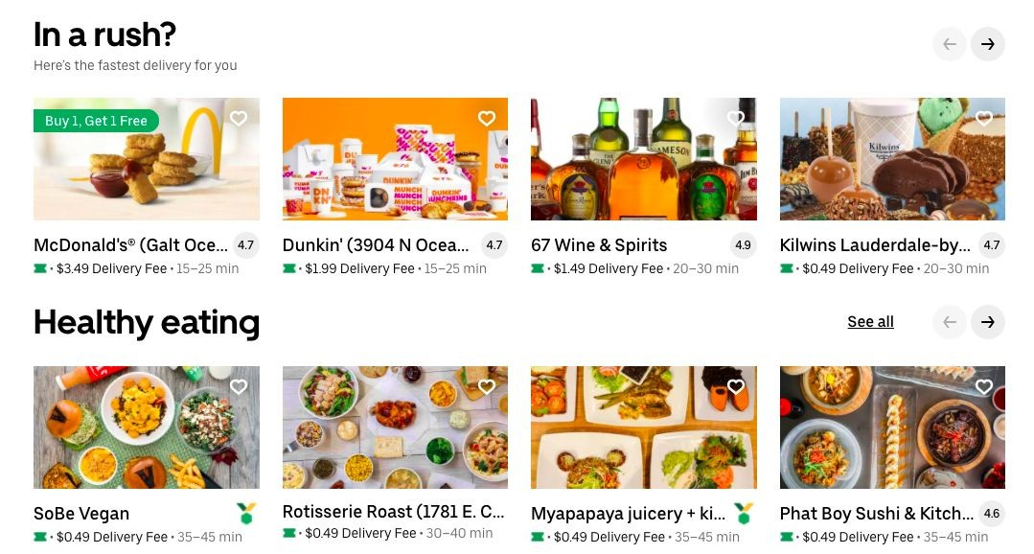
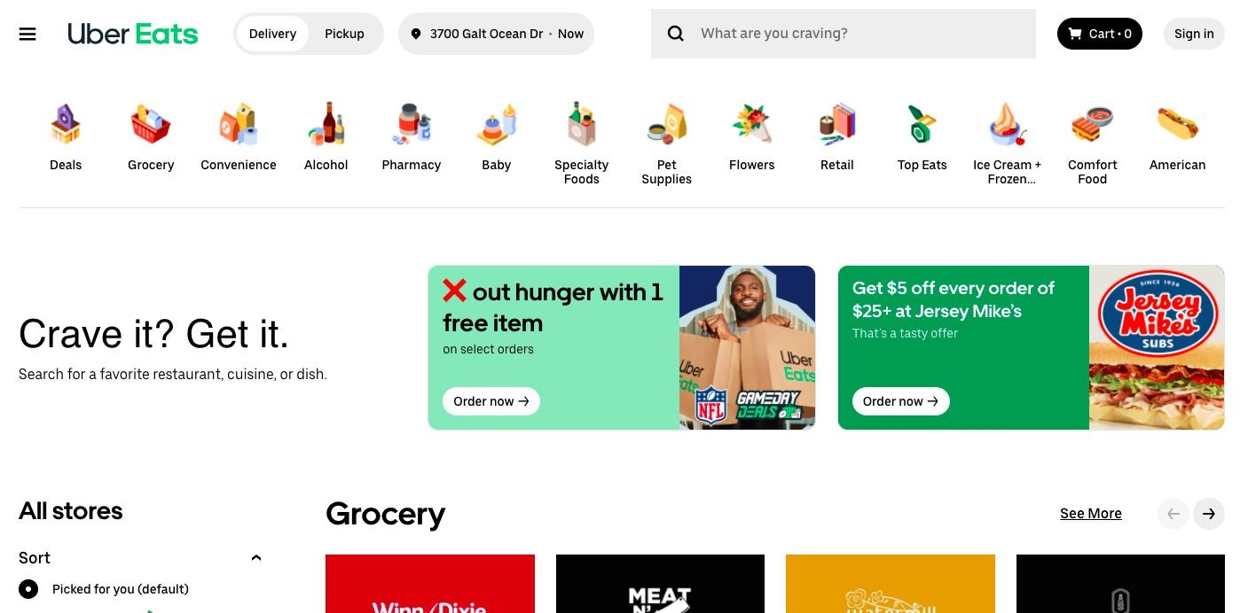
REVIEW IT: Treatment A and B: fewer or more details?
Fewer details with
less information on the order page
More details with
more information on the order page
A
B

Slide 6
REVIEW IT: Calculating p-values
Review step-by-step instructions for collecting inputs from an experiment in a spreadsheet, then use an online calculator to calculate the p-value.
See the spreadsheet with observations from an experiment being conducted to determine whether adding a specific feature to an online ad will lead to a higher
click-through rate.
Access the calculator Devanshu used to conduct a Z-test for two population proportions.
REVIEW IT
SEE IT
ACCESS IT

Slide 7
REVIEW IT: Experiment set up instructions
For this experiment, the null and alternative hypotheses have already been set up.
The null and alternative hypotheses
The null hypothesis is that the average click through rate for the displays is the same. The alternative hypothesis is that the average click through rate for the displays is different.
The data
Access the data associated with this experiment.
Make your own copy of the dataset in order to answer the questions on the following slides.

Slide 8
TRY IT: What are your null and alternative hypotheses
QUESTION | YOUR ANSWERS
What is the null hypothesis? | The null hypothesis is that the average click through rate for the displays is the same. Or, Null Hypothesis (H0): the average click through rate for the displays is the same.
What is the alternative hypothesis? | The alternative hypothesis is that the average click through rate for the displays is different. Or, Alternative Hypothesis (H1): the average click through rate for the displays is different.

Slide 9
TRY IT: Calculate treatment sample sizes
QUESTION | YOUR ANSWERS
How many customers saw ‘Treatment A’? | In this experiment, the total number of customer saw ‘Treatment A’ (i.e., takes value zero) is 106.
How many customers saw ‘Treatment B’? | In this experiment, the total number of customer saw ‘Treatment B’ (i.e., takes value one) is 94.
What is the total number of customers in the experiment? | The total number of customers in this experiment is 200. In other words, the sample size (n) of the data set is 200.

Slide 10
TRY IT: Select a testing method and write ship criteria
QUESTION | YOUR ANSWERS
What is the CTR proportion for ‘Treatment A’?
What is the CTR integer value for ‘Treatment A’?
What is the CTR proportion for ‘Treatment B’?
What is the CTR integer value for ‘Treatment B’?

Slide 11
TRY IT: Calculate your p-value and make a ship decision
QUESTION | YOUR ANSWERS
What is the p-value?
What’s your Type I error threshold?
Which hypothesis do you choose?
Access the link to the online calculator used in the module

Slide 12
_{REFLECT ON IT:} What confounding variables could be hidden in
your results?
Reflect on what you learned in this module. There wasn’t a lot of information provided about the data collection for this experiment. Think about what confounding variables might exist in this analysis.
1. Possible confounding variables to these experiment results include….

Slide 13
_{REFLECT ON IT:} What else might we do to increase the chances
of finding a difference?
Reflect on what you learned in this module. If you weren’t constrained to this dataset, what else could you do to improve the chance of finding statistically significant differences between version A and version B of this page?
1. Possible extensions of this experiment that might lead to finding statistically significant differences include….

Slide 14
SUBMIT IT: Share link to your completed assignment
ACTION | INSTRUCTIONS | NOTES
REVIEW | Review each item and make sure you have completed an answer for each in the appropriate location
ACCESS | Go back to the Assignment in the Learning Management System
SHARE | Copy/paste the link to your Assignment in the system by the due date. Make sure anyone on the internet with the link can view the document.
CONFIRM | Make sure the assignment was accepted by the Learning Management System

